Slide 1
C Programming Language
February 7, 2015

Slide 2
Today’s task
va_list
Binary tree

Slide 3
Question
We need a function that will accept any number of values and return the average
Usually the number of values function will accept is fixed
va_list is needed

Slide 4
va_list
#include <stdlib.h>
#include <stdio.h>
#include <stdarg.h>
double average(int x,...)
{
int i;
va_list lst;
double sum = 0;
va_start(lst,x);
for (i=0;i<x;i++)
{
sum += va_arg(lst,double);
}
va_end(lst);
return sum / x;
}
#include <stdarg.h>
va_list
va_start
va_arg
va_end

Slide 5
va_list
double average(int x,...)
{
int i;
va_list lst;
double sum = 0;
va_start(lst,x);
for (i=0;i<x;i++)
{
sum += va_arg(lst,double);
}
va_end(lst);
return sum / x;
}
int main()
{
printf("%0.2f\n",average(5,1.0,2.0,3.0,4.0,5.0));
return 0;
}

Slide 6
va_list
Have to be sure about the type of input value
Not flexible
Not a good idea to use va_list all time

Slide 7
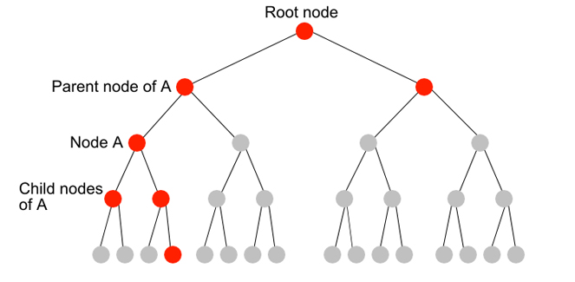
Binary trees
struct node
{
int key_value;
struct node* left;
struct node* right;
};

Slide 8
Homework
Suppose we have two sorted linked list, merge the two list together and keep the new linked list still sorted
E.g.
Merged result
1
3
5
0
2
4
6
0
1
2
3
4
5
6
0

Slide 9
Next time
Binary tree
va_list

